Slide 1

School Computer Safety
By Andress Silva
Presented by

Slide 2
STEM lab log-out
Public space = higher risk

Slide 3
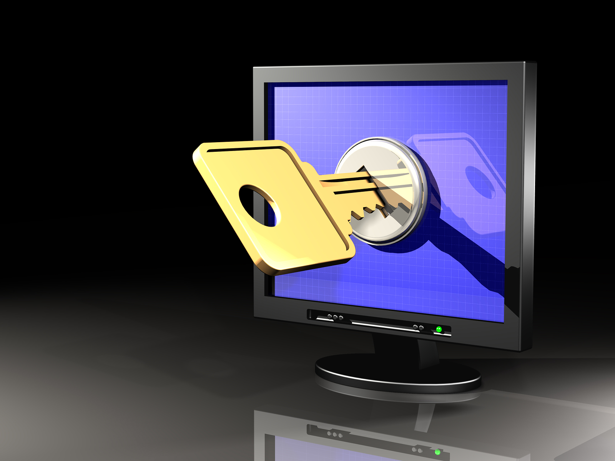
Why to name your usb
Proof of ownership

Slide 4
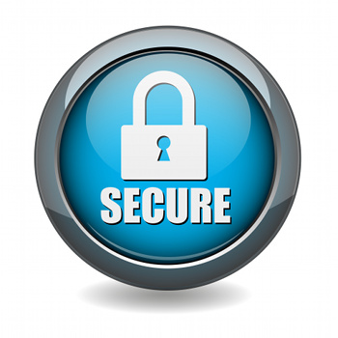
USB Encryption
There are a few reputable and easy to use sources such as
Bitlocker To Go (Microsoft)
http://www.microsoft.com/en-us/download/details.aspx?id=24303
For the more experienced, there are free and open source options
DiskCryptor
Rohos Mini Drive
SecurStick

Slide 5
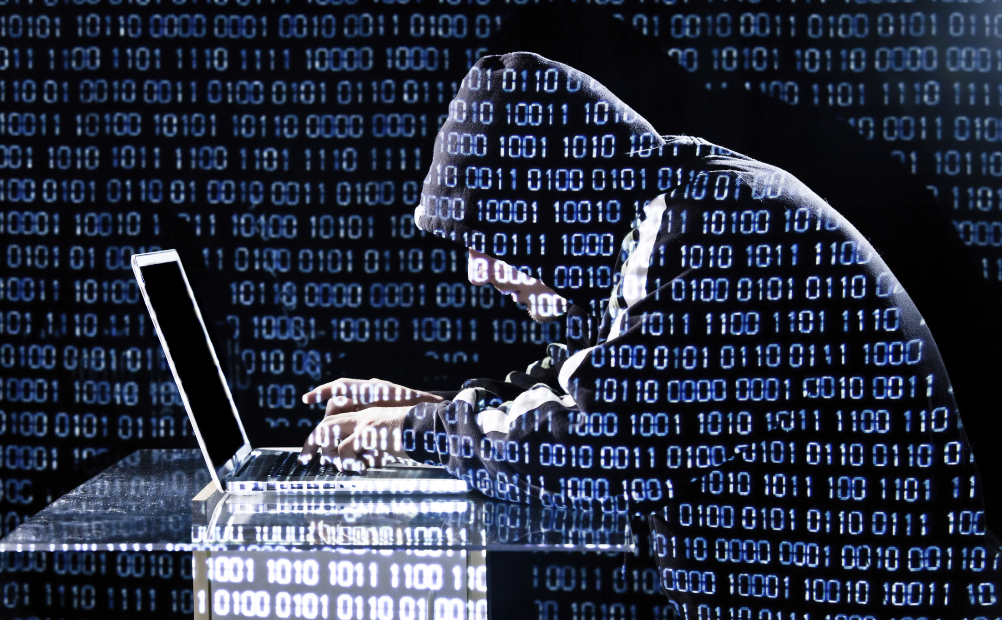
Why to shut down your computer
Erases all data

